Slide 1
EE 5453 – 002
Engineering Programming II
Python Statements & Functions
Guenvere (Qian) Chen

Slide 2
Python Conceptual Hierarchy
Programs are composed of modules
Modules contain statements
Statements contain expressions
Expressions create and process objects

Slide 3
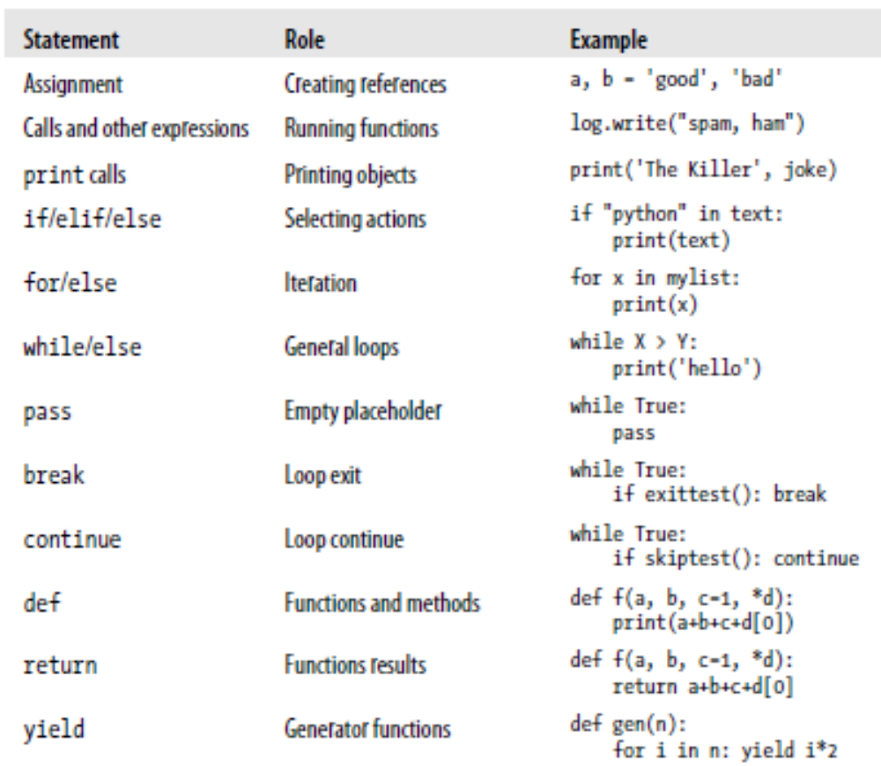
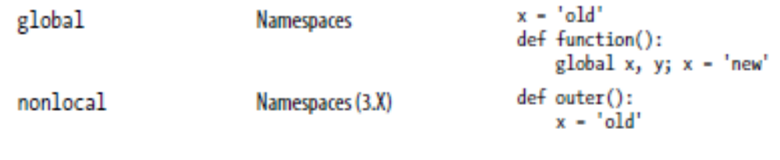
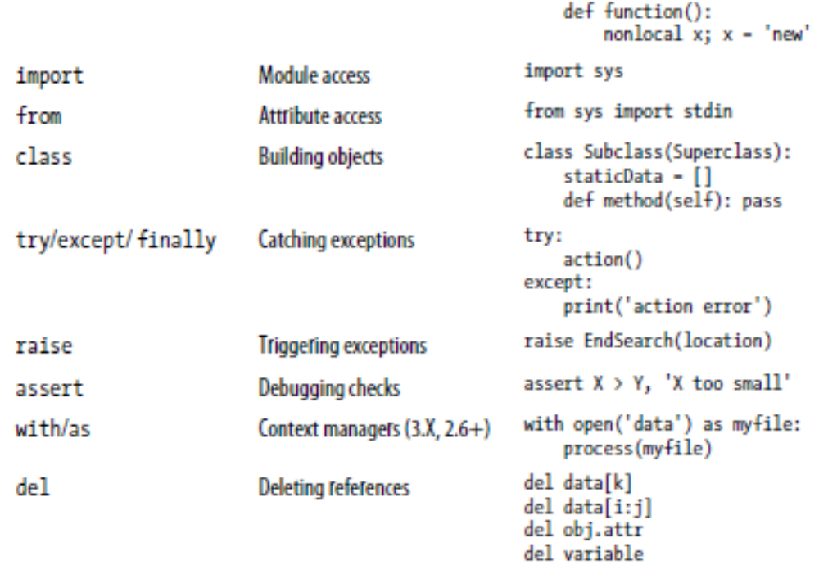
Python Statements Overview

Slide 4
Sequence Assignments
>>> nudge = 1 # basic assignment.
>>> wink = 2
>>> A, B = nudge, wink # tuple assignment
>>> A, B
(1, 2)
>>> [C, D] = [nudge, wink] # list assignment
>>> C, D
(1, 2)
>>> nudge, wink = wink, nudge # swap
>>> nudge, wink
(2, 1)
>>> [a, b, c] = (1, 2, 3)
# assign tuple of values to list of names
>>> a, c
(1, 3)
>>> (a, b, c) = “ABC”
>>> a, c
(‘A’, ‘C’)

Slide 5
Advanced Sequence Assignments
>>> string = ‘SPAM’
>>> a, b, c, d = string
>>> a, d
(‘S’, ‘M’)
>>> a, b, c = string
……
ValueError: too many values to unpack (expected 3)
>>> a, b, c = string[0], string[1], string[2:]
>>> a, b, c
(‘S’, ‘P’, ‘AM’)
>>> (a, b), c = string[:2], string[2:]
>>> a, b, c
(‘S’, ‘P’, ‘AM’)
>>> red, green, blue = range(3)
>>> red, blue
(0, 2)

Slide 6
Extended Sequence Unpacking
New in Python 3
Use a single starred name in the target to match more generally
The starred name can appear anywhere in the target
>>> *a, b = seq
>>> a
[1, 2, 3]
>>> b
4
>>> a, *b, c = seq
>>> a, b, c
(1, [2, 3], 4)
>>> seq = [1, 2, 3, 4]
>>> a, b, c, d = seq
>>> print(a, b, c, d)
1 2 3 4
>>> a, b = seq
ValueError: too many values to unpack
>>> a, *b = seq
>>> a
1
>>> b
[2, 3, 4]

Slide 7
Extended Sequence Unpacking (Cont.)
Boundary cases:
>>> seq = [1, 2, 3, 4]
>>> a, b, c, *d = seq
>>> print(a, b, c, d)
1 2 3 [4]
>>> a, b, c, d, *e = seq
>>> print(a, b, c, d, e)
>>> 1 2 3 4 []
>>> a, *b, c, *d = seq
SyntaxError: two starred expression in assignment
>>> *a = seq
SyntaxError: starred assignment target must be in a list or tuple
>>> *a, = seq
>>> a
[1, 2, 3, 4]
Works for any sequence types:
>>> a, *b, c = ‘spam’
>>> a, b, c
(‘s’, [‘p’, ‘a’], ‘m’)
>>> a, *b, c = range(4)
>>> a, b, c
(0, [1, 2], 3)

Slide 8
The range() Function
>>> for i in range(3):
... print(i)
...
0
1
2
>>> a = ['Mary', 'had', 'lamb']
>>> for i in range(len(a)):
... print(i, a[i])
...
0 Mary
1 had
2 lamb
A few range() examples:
range(5, 10): 5, 6, 7, 8, 9
range(0, 10, 3): 0, 3, 6, 9
range(-10, -100, -30): -10, -40, -70
Useful for iterating over a sequence of numbers
  range(int n) generates: 0, 1, …, n-1
  range(int m, int n) generates: m, m+1, …, n-1
  range(int m, int n, int s) generates: m, m+s, m+2*s, …, up to n-1
The given end point is never included

Slide 9
Multiple-Target Assignments
Be cautious when initializing variables to an empty mutable object
>>> a = b = []
>>> b.append(42)
>>> a, b
([42], [42])
>>> a, b = [], []
>>> b.append(42)
>>> a, b
([], [42])
>>> a = b = c = ‘spam’
>>> a, b, c
(‘spam’, ‘spam’, ‘spam’)

Slide 10
Augmented Assignments
Concatenation (“+”) makes a new object, but “+=” is an in-place change.
>>> L = [1, 2]
>>> M = L # L and M reference the same object
>>> L = L + [3, 4] # “+” makes a new object
>>> L, M
([1, 2, 3, 4], [1, 2])
>>> L = [1, 2]
>>> M = L
>>> L += [3, 4] # “+=“ is an in-place change
>>> L, M
([1, 2, 3, 4], [1, 2, 3, 4])
>>> L = [1, 2]
>>> L = L + [3]
>>> L
[1, 2, 3]
>>> L += [9, 10]
>>> L
[1, 2, 3, 9, 10]

Slide 11
Print Operations (Python 3)
By default, print calls add a space between the objects printed
>>> x = ‘spam’
>>> y = 99
>>> z = [‘eggs’]
>>> print(x, y, z)
spam 99 [‘eggs’]
The separator can be customized
>>> print(x, y, z, sep=‘’)
spam99[‘eggs’]
>>> print(x, y, z, sep=‘, ’)
spam, 99, [‘eggs’]

Slide 12
Print Operations (Cont.)
By default, print adds an end-of-line character to terminate the output line.
This can also be suppressed or customized
>>> print(x, y, z, end=‘’); print(x, y, z)
spam 99 [‘eggs’]spam 99 [‘eggs’]
>>> print (x, y, z, sep=‘…’, end=‘!\n’)
spam…99…[‘eggs’]!

Slide 13
if Statements
>>> x = 3
>>> if x < 0:
... x = 0
... print('Negative changed to zero')
... elif x == 0:
... print('Zero')
... elif x == 1:
... print('Single')
... else:
... print('More')
...
More
There can be zero or more elif parts, which are short for “else if”.
The else part if optional
An if…elif…elif… sequence is a substitute for the switch or case statements in other languages

Slide 14
While Statements
while True:
reply = input(‘Enter text:’)
if reply == ‘stop’:
break
print(reply.upper())
The input(str) built-in function is for general console input. It prints out the optional argument string as a prompt and returns the user’s typed reply as a string.

Slide 15
Enhanced With Error Handling
while True:
reply = input(‘Enter text:’)
if reply == ‘stop’:
break
print(int(reply) ** 2)
print(‘Bye’)
Enter text:2
4
Enter text:40
1600
Enter text:stop
Bye
while True:
reply = input(‘Enter text:’)
if reply == ‘stop’:
break
try:
num = int(reply)
except:
print(‘Bad!’ * 8)
else:
print(num ** 2)
print(‘Bye’)

Slide 16
for Statements
>>> words = ['cat', 'window', 'defenestrate']
>>> for w in words:
... print(w, len(w))
...
cat 3
window 6
defenestrate 12
>>> for w in words[:]:
... if len(w) > 6:
... words.insert(0, w)
...
>>> words
['defenestrate', 'cat', 'window', 'defenestrate']
Iterates over the items of any sequence (a list, a string, etc.)
If you need to modify the sequence while inside the loop, you should make a copy first (e.g., using slicing)

Slide 17
break Statements
>>> for n in range(6, 10):
... for x in range(2, n):
... if n % x == 0:
... print(n, 'equals', x, '*', n//x)
... break
... else:
... print(n, 'is a prime number')
...
6 equals 2 * 3
7 is a prime number
8 equals 2 * 4
9 equals 3 * 3
The break statement breaks out of the smallest enclosing for or while loop.
Loops may have an else clause; it’s executed when: (1) the loop terminates through exhaustion of the list (with for), or (2) when the condition becomes false (with while)
  So the else clause is not executed when the loop is terminated by a break

Slide 18
continue and pass statements
The continue statement continues with the next iteration of the loop
>>> for num in range(6, 10):
... if num % 2 == 0:
... print("Found an even number", num)
... continue
... print("Found a number", num)
Found an even number 6
Found a number 7
Found an even number 8
Found a number 9
The pass statement does nothing, and can be used when a statement is required syntactically but the program requires no action.
>>> while True:
… pass
>>> class MyClass:
… pass
>>> def my_func(arg):
… pass

Slide 19
Changing Lists
Using indices to refer to items:
>>> L = [1, 2, 3, 4]
>>> for i in range(len(L)):
… L[i] += 1
…
>>> L
[2, 3, 4, 5]
Using a while loop:
>>> i = 0
>>> while i < len(L):
… L[i] += 1
… i += 1
…
>>> L
[3, 4, 5, 6]
Using a list comprehension:
>>> L = [x + 1 for x in L]
How to modify the items of a list?
>>> L = [1, 2, 3, 4]
>>> for x in L:
… x += 1
…
>>> x
5
>>> L
[1, 2, 3, 4]

Slide 20
Parallel Traversals – zip
The built-in function zip takes one or more sequences as arguments and returns a series of tuples that pair up parallel items taken from those sequences.
>>> L1 = [1, 2, 3, 4]
>>> L2 = [5, 6, 7, 8]
>>> zip(L1, L2)
<zip object at 0x026523C8>
>>> list(zip(L1, L2))
[(1, 5), (2, 6), (3, 7), (4, 8)]
>>> for (x, y) in zip(L1, L2):
… print(x, y, ‘--’, x+y)
…
1 5 -- 6
2 6 -- 8
3 7 -- 10
4 8 -- 12

Slide 21
Parallel Traversals – zip (Cont.)
zip accepts any type of sequence
zip accepts more than two arguments
>>> T1, T2, T3 = (1, 2, 3), (4, 5, 6), (7, 8, 9)
>>> T3
(7, 8, 9)
>>> list(zip(T1, T2, T3))
[(1, 4, 7), (2, 5, 8), (3, 6, 9)]
zip truncates result tuples at the length of the shortest sequence when the argument lengths differ
>>> S1 = ‘abc’
>>> S2 = ‘xyz123’
>>> list(zip(S1, S2))
[(a, x), (b, y), (c, z)]

Slide 22
Dictionary Construction
>>> keys = [‘spam’, ‘eggs’, ‘toast’]
>>> vals = [1, 3, 5]
>>> D2 = {}
>>> for (k, v) in zip(keys, vals): D2[k] = v
…
>>> D2
{‘eggs’: 3, ‘toast’: 5, ‘spam’: 1}
>>> D3 = dict(zip(keys, vals))
>>> D3
{‘eggs’: 3, ‘toast’: 5, ‘spam’: 1}
>>> {k:v for (k, v) in zip(keys, vals)}
{‘eggs’: 3, ‘toast’: 5, ‘spam’: 1}
How to construct a dictionary?
>>> D1 = {‘spam’:1, ‘eggs’:3, ‘toast’:5}
>>> D1
{‘eggs’: 3, ‘toast’: 5, ‘spam’: 1}
>>> D1 = {}
>>> D1[‘spam’] = 1
>>> D1[‘eggs’] = 3
>>> D1[‘toast’] = 5

Slide 23
Getting Both Offsets and Items
How to get both offsets and items:
>>> S = ‘spam’
>>> offset = 0
>>> for item in S:
… print(item, ‘appears at’, offset)
… offset += 1
…
s appears at 0
p appears at 1
a appears at 2
m appears at 3
Using the built-in enumerate function:
>>> S = ‘spam’
>>> for (offset, item) in enumerate(S):
… print(item, ‘appears at’, offset)
…
s appears at 0
p appears at 1
a appears at 2
m appears at 3

Slide 24
Iterations
>>> for x in [1, 2, 3]: print (x ** 2, end=‘ ’)
…
1 4 9
>>> print(open(‘script.py’).read())
import sys
print(sys.path)
x = 2
print(x ** 32)
>>> f = open(‘script.py’)
>>> f.readline()
‘import sys\n’
>>> f.readline()
‘print(sys.path)\n’
>>> f.readline()
‘x = 2\n’
>>> f.readline()
‘print(x ** 32)\n’
>>> f.readline()
‘’

Slide 25
Defining Functions
>>> def fib(n):
... result = []
... a, b = 0, 1
... while a < n:
... result.append(a)
... a , b = b, a+b
... return result
...
>>> f100 = fib(100)
>>> f100
[0, 1, 1, 2, 3, 5, 8, 13, 21, 34, 55, 89]
Multiple assignment: the expressions on the right are all evaluated (from left to right) first before any assignment takes place.
Therefore, we can swap two variables like below:
>>> x, y = y, x

Slide 26
Polymorphism in Python
def intersect(seq1, seq2):
res = []
for x in seq1:
if x in seq2:
res.append(x)
return res
>>> s1 = ‘SPAM’
>>> s2 = ‘SCAM’
>>> interest(s1, s2)
[‘S’, ‘A’, ‘M’]
>>> interest([1, 2, 3], (1, 4))
>>> [1]
The meaning of an operation depends on the objects being operated upon
If the objects passed do not support the expected interface, raise an exception automatically
>>> def times(x, y):
… return x * y
…
>>> times(2, 4)
8
>>> times(‘Hi’, 4)
‘HiHiHiHi’

Slide 27
Scopes And Namespaces
A namespace is a mapping from names to objects
No relation between names in different namespaces
Examples of namespaces:
  The set of Python built-in names
  The global names in a module
  The local names in a function
  The attribute names in a class object
  The attribute names in a class
  ……
Use namespace.attribute to access an attribute in a namespace:
  E.g. modname.funcname, object.data, etc.
Writable attributes may also be deleted with the del statement

Slide 28
Python Functions: Arguments Pass by Value
>>> def f(a):
a = 99
>>> b = 88
>>> f(b)
>>> print(b)
88
>>> def changer(a, b):
a = 2
b[0] = 'spam'
>>> X = 1
>>> L = [1, 2]
>>> changer(X, L)
>>> X, L
(1, ['spam', 2])

